Slide 1
JAVA 8 Distilled

Slide 2
Outline
LAMBDA EXPRESSIONS
Streams and collectors
Date and Time
Strings, I/o and bits & pieces

Slide 3
Lambda expression
A cute little way of writing anonymous class
To make instance of anonymous classes easier to read & write

Slide 4
3-questions about lambda
What is type of lambda expression ?
Can lambda be put in a variable ?
Is lambda expression an object ?

Slide 5
Functional interface
Lambda is a type of functional interface
A functional interface is an interface with only one abstract method
Methods from object class doesn’t count
Can annotate with @FunctionalInterface

Slide 6
Lambda expression in a variable
Answer is yes!
Comparator<string> c = (string s1,string s2) -> integer.Compare(s1.Length(), s2.Length());
Lambda can be taken as method parameter and can be returned by a method, leading to higher order functions.

Slide 7
Is lambda expression an object
Java8 closures are neither syntactic sugar nor are they first-class values
A lambda is an object with out an identity
Leads to a java.Util.Function package
Notes:
Yes and No. Yes, Java 8 will have considerably more type inference than Java 7, and No, there is not a "new" type system in Java 8, although there are some minor changes
Java 8 will still be statically typed, and it will still have the dichotomy between classes and interfaces. There are no new types such as function types. The type of a lambda is essentially a "functional interface" which is an ordinary interface with a single abstract method.
Interfaces can now have code in the form of default methods, but the model of single-inheritance of classes and multiple inheritance of interfaces remains the same. There are some adjustments, of course, such as rules for method resolution in the presence of default methods, but the fundamentals are unchanged.

Slide 8
Java.util.function
Four categories
Supplier
Consumer (Biconsumer)
Predicate (Bipredicate)
Function (bifunction)
Unary operator
Binary operator

Slide 9
Method reference An alternative syntax for lambda expression
Static Method (Class::staticMethod)
Instance method of an object of particular type (Objecttype::instanceMethod)
Instance method of existing object(Object::instanceMethod)
Constructor (::new)
Notes:
Alternate way to write lambda expressions

Slide 10
So far ?
A new concept : lambda expression
A new interface concept: functional interface
Question: how can we process the data ?

Slide 11
Processing Data
Yes ! Use lambda’s to process data
forEach(Consumer);
personMap.forEach((year,persons) -> System.out.println(year + " "+ persons));
forEach() is a default method on java.util.Iterable
Java 8 now allows default methods on interface
Static method on interface

Slide 12
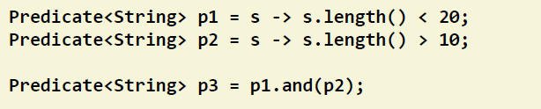
New patterns
boolean isGT10Less20 = p3.test(“hello world”);
Notes:
Take to java.util.predicate package

Slide 13

Streams
What is a stream ?
A typed interface
What does it do ?
Efficiently process data
In parallel, leveraging the multi-core CPUs
Piplined, to avoid un-necessary intermediate computation

Slide 14
So stream is….
An object on which on can define operations
An object that doesn’t hold any data
An object that shouldn’t change the data it process
An object able to process data in one pass
Able to process data in parallel

Slide 15
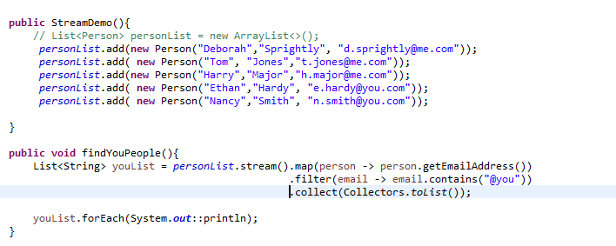
Streams
Processing typically on streams are map/filter/reduce

Slide 16
Streams Operations
The <<consuming>> operations : forEach(), peek()
The <<mapping>> operations: map(), flatMap()
The <<filter>> operations: filter()
The <<reduction>> operations:
Aggregations: reduce(), max(), min()…..
Mutable reductions: collect, Collectors

Slide 17
Date Api
New package java.time
New Key concepts
Interoperability with java.util.date

Slide 18
Instant
Instant Is a point on timeline
Instant 0 Is jan 1st 1970 midnight gmt
Instant.min 1 Billion years ago
Instant.max Is Dec 31 of 1,000,000,000
Instant.now() – Current
Notes:
Instant is immutable

Slide 19
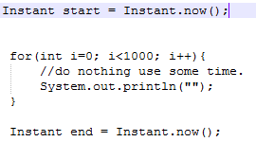

Instant
How to use
New concept – duration
Tonanos(), plusnanos(), iszero(), multipliedby()
Notes:
Duration is amount of time between two Instants
How do we represent a date then, like my birthday,

Slide 20

LocalDate
We need a concept for dates
Period is amount of time between two local dates
Notes:
Same concept as Duration and same methods.

Slide 21
Date Adjuster
Useful to add (substract) an amount of time to an Instant or a Localdate
Use the method with()
LocalDate nextsunday = now.with(TemporalAdjusters.nextOrSame(DayOfWeek.SUNDAY));
TemporalAdjusters – 14 static methods to adjust Instant or LocalDate

Slide 22

LocalTime
A LocalTime is time of a day
Pattern
Plus a set of methods to manipulate time

Slide 23


Zoned Time
How to create a Zoned time
Add time
Change TimeZone

Slide 24
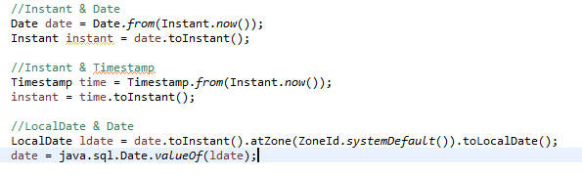
Interoperability

Slide 25
Bits & Pieces
String
Java I/O
Comparator
Collections
Numbers
Map
Annotations

Slide 26

String
StringJoiner
Output → {tmhp,riata trace pkyw,austin}

Slide 27
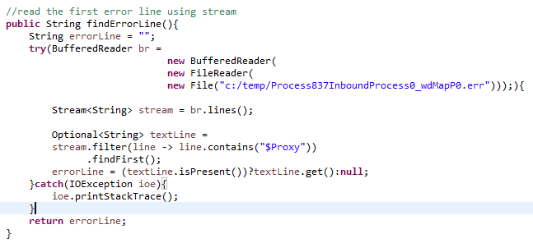
I/O – read text files
Using BufferedReader

Slide 28
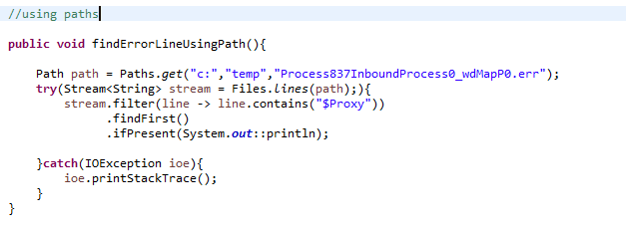
I/O – read text files
Using Paths

Slide 29
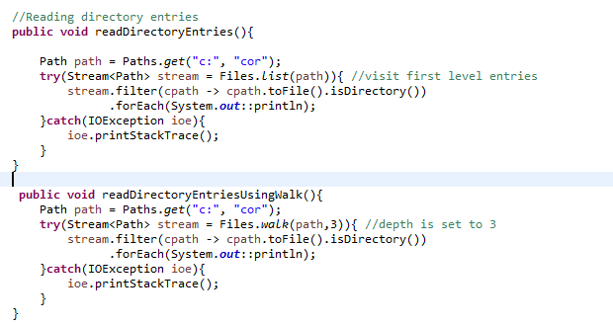
I/O- Reading Directories
Files.list()
Files.walk()

Slide 30

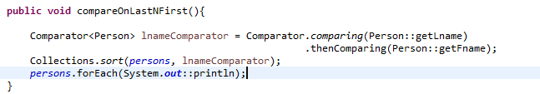
Comparator
Using comparing()
Using thenComparing()
Notes:
naturalOrder()
Reversed()
nullsFirst()
nullsLast()

Slide 31
Collections
Java Package | methods
Collections | Stream(), parallelStream(), splitIterator(), removeIf()
Iterable | forEach()
List | replaceAll(), sort()

Slide 32
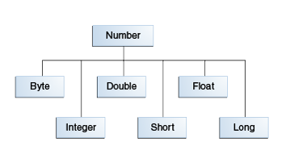
Numbers
They all got wrapper type
Useful methods (sum, max, min)
Long.max(10l,15l);
Reduction operations
BinaryOperator<Long>sum = Long::sum;

Slide 33
Map
New methods
forEach(BiConsumer)
getOrDefault(Key,DefaultValue)
putIfAbsent(Key,Value)
replace(Key, oldValue, newValue)
replaceAll(BiFunction)
remove(Key, Value)
compute(Key, BiFunction)
computeIfAbsent(Key, Function)
computeIfPresent(Key, BiFunction)
merge(Key, Value, BiFunction)

Slide 34
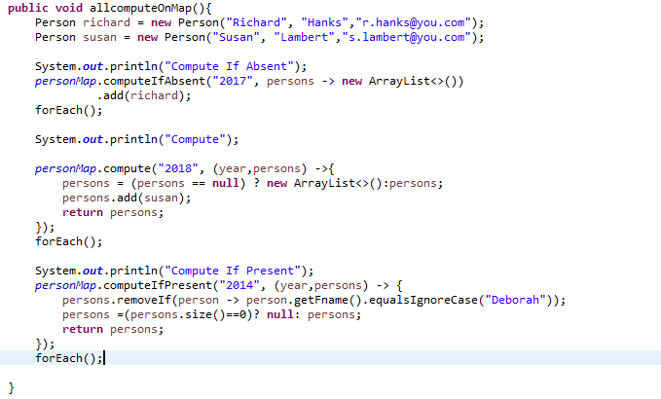
Map methods

Slide 35
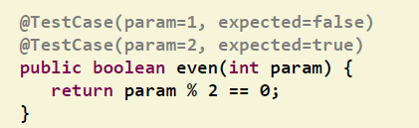
Annotations
Pre java-8 same annotation cannot be applied on same method
With java 8
Annotation on types

Slide 36
Thank you
GitHub url:
https://github.com/rmalired/java8-intro.git

